Slide 1
Supporting your child with writing in the Early Years

Slide 2
Overview
The importance of spoken language (oracy)
How we support reading and writing
Developing fine motor skills
The stages of writing development
An explanation of the end of year expectations
How you can help at home

Slide 3
Children’s spoken language supports reading and writing
Speaking and listening are the foundations for both reading and writing.
Promote a love of reading.
Encourage storytelling/retelling of familiar stories.
Widen vocabulary.
Explore different genres – fiction, non-fiction, magazines, poems, familiar rhymes.
Comprehension.

Slide 4
How we support reading and writing
Phonics
Fiddly fingers – finger gym
Dough disco
Handwriting
Poetry picnic, songs and rhymes
Library visits
Reading practice (4 times a week) – Little Wandle
Purposeful writing challenges in provision
Phonics writing activities
Story times

Slide 5
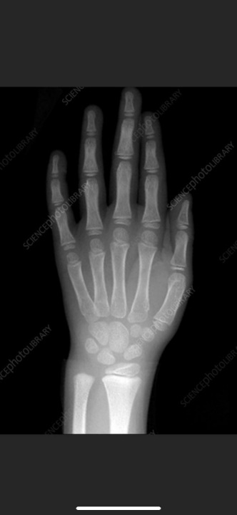
An x ray of a developed hand (around the age of 7) on the left compared to an EYFS age child’s hand on the right.
Why fiddly finger and mark-making activities are so important

Slide 6
Beginning to write
Physical development is very important in this process.
Gross motor – large full arm movements.
Fine motor - letter formation/pencil control.
Independence – encouragement to “just have a go”.
Write as many sounds as they can.
Importance of writing for a purpose.
Praise and encouragement.
Making it fun!

Slide 7
Pencil grip is important.

Slide 8
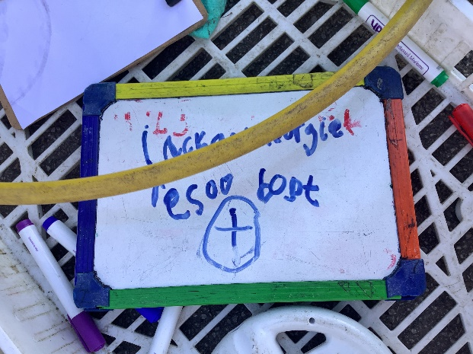
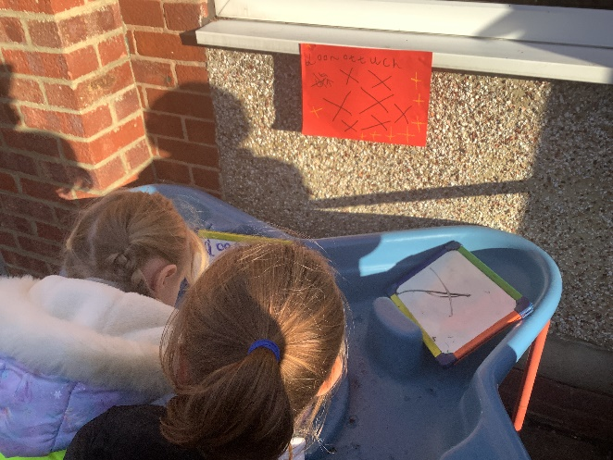
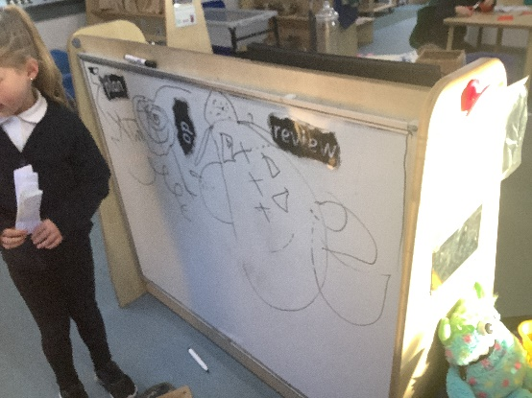
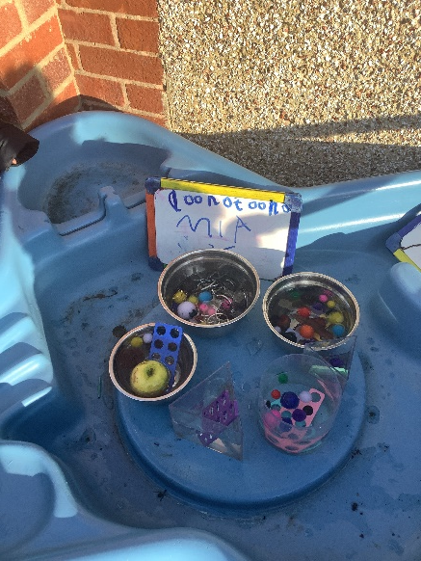
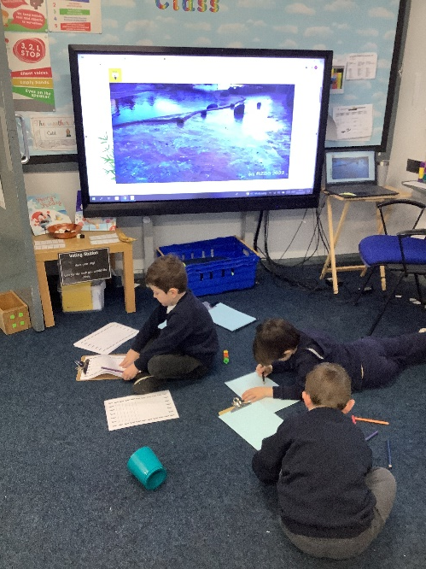
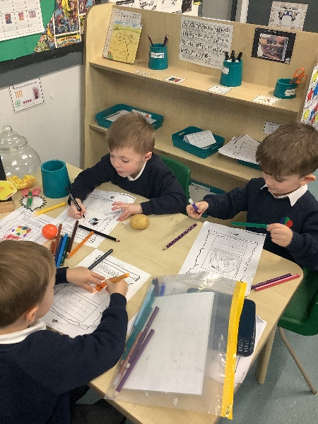
Writing for a purpose
.
maps
labelling models
registers, lists…
making observations
wanted posters

Slide 9
Developmental progression of a child’s writing.

Slide 10
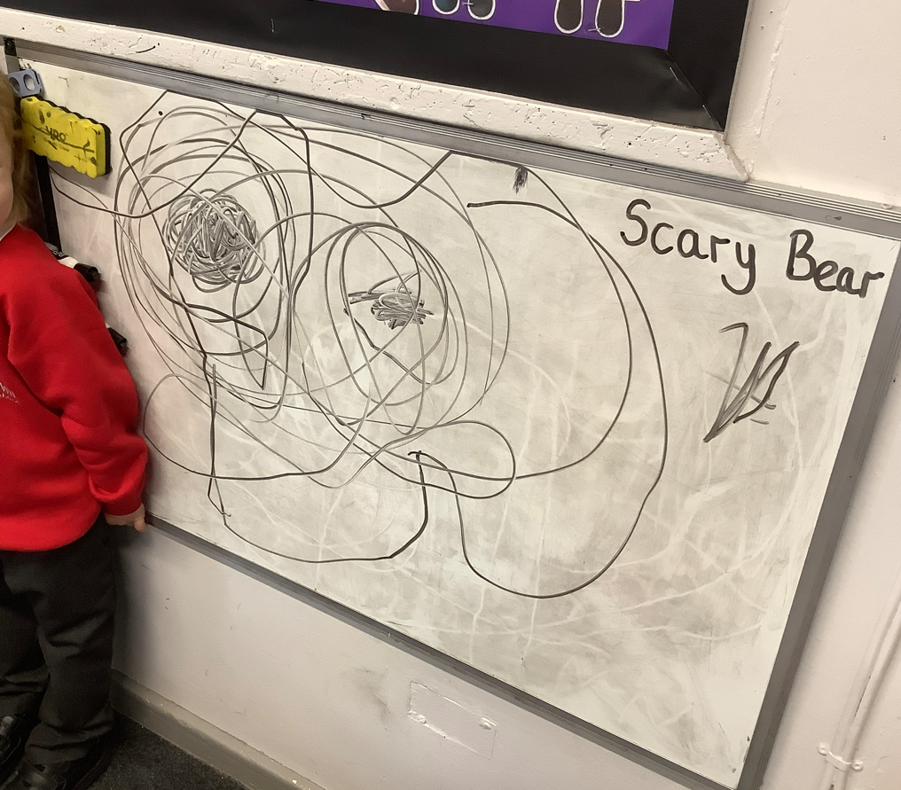
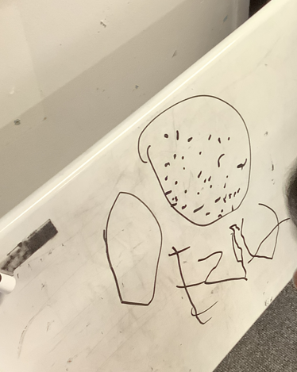
Emergent writing
This is a form of mark-making that purely imitates the idea of writing. The marks will be placed at any point on the page, and will usually involve circular strokes and random marks.

Slide 11
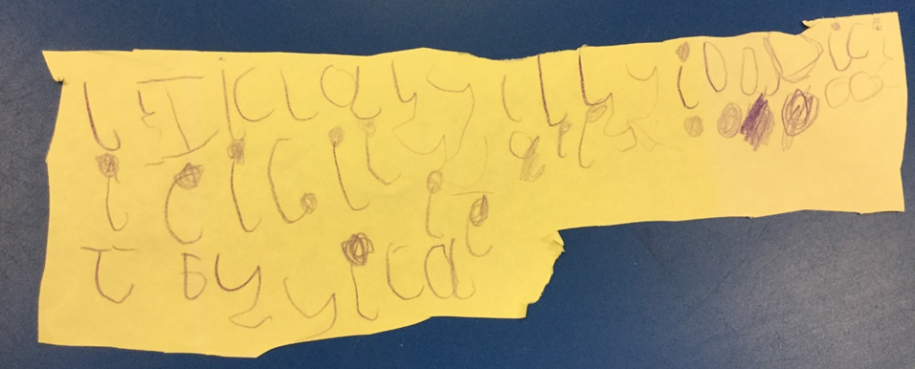
Beginning to use familiar letters Emergent writing starts with strings of letters.

Slide 12
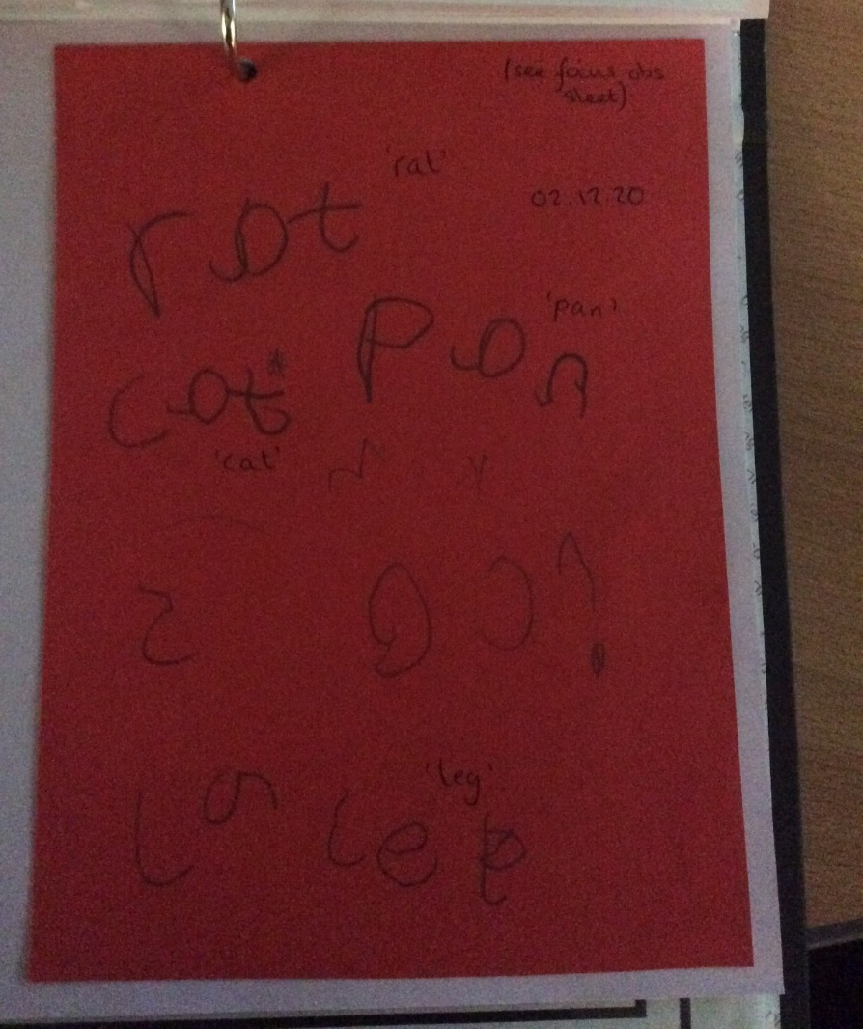
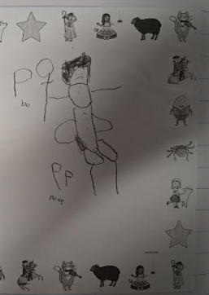
Some sound correspondence
You will see your child begin to use letters to represent sounds or whole words.

Slide 13
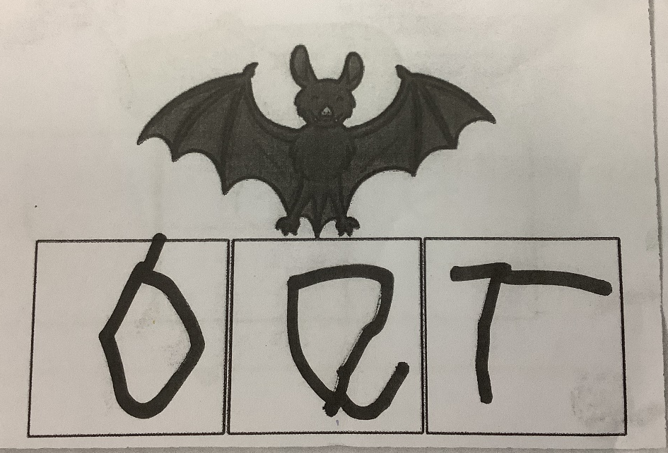
Phonetic spelling
As the children hear more sounds in words their writing becomes more recognisable. They will start to correctly sequence the graphemes/phonemes they have learnt in phonics.

Slide 14
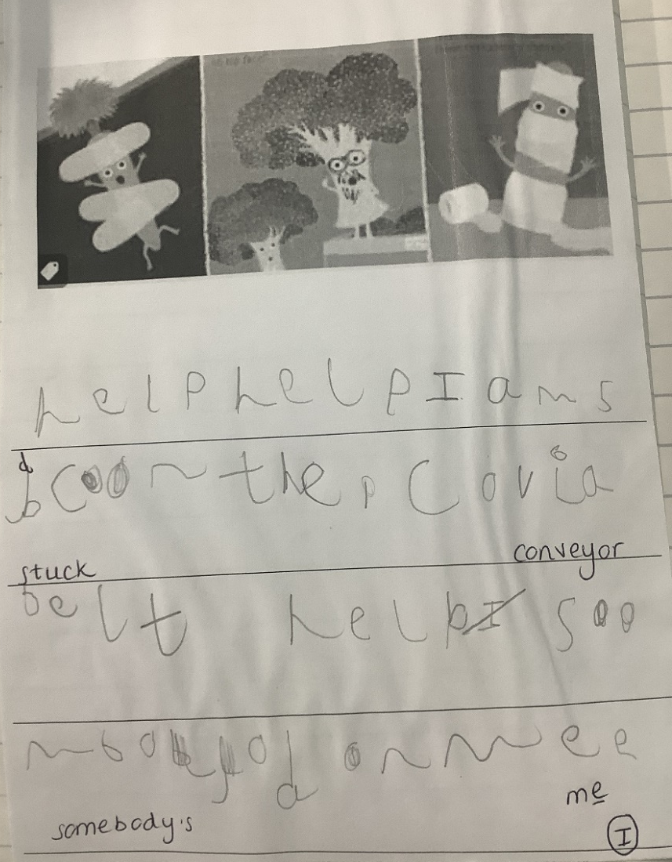
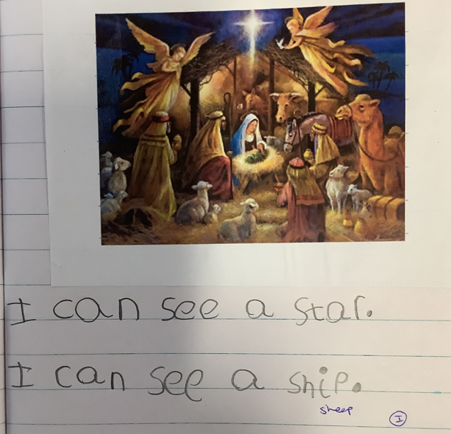
Writing simple captions and sentences
These will start to include the correct spelling of tricky words.
Notes:
…point out phonetically spelt words… not always spelling correctly…

Slide 15
End of the year expectations
We are on the journey in Reception to be fantastic writers. This is what we need to do to reach a Good Level of Development in writing.
Write recognisable letters, most of which are correctly formed.
Spell words by identifying sounds in them and representing the sounds with a letter or letters.
Write simple phrases and sentences that can be read by others.

Slide 16
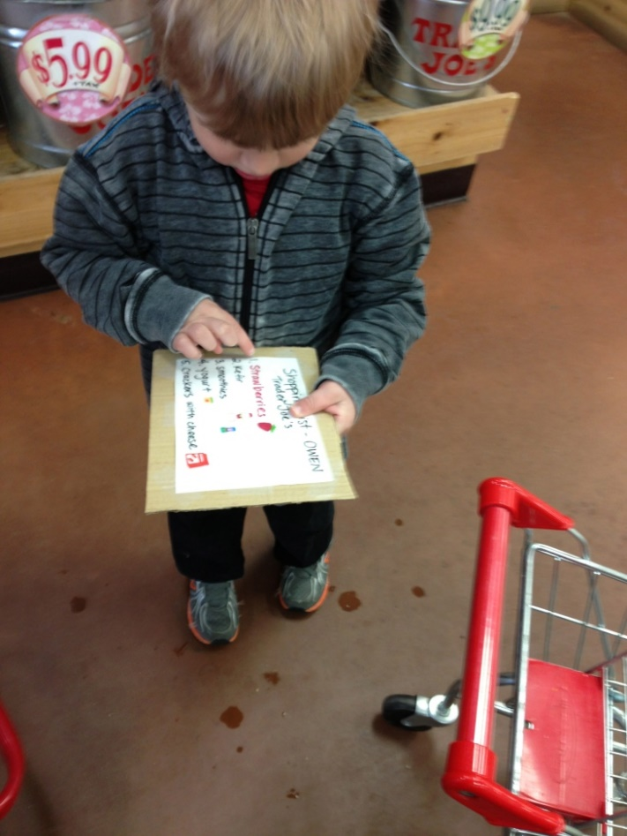
How you can help at home
Writing for a purpose.
Writing shopping lists, to do lists.
Post it notes for messages.
Writing cards, letters, postcards.
Labelling pictures that they have drawn.
Writing ingredients and recipes.
Notes:
Not copy writing

Slide 17
How you can help at home
Notes:
ADD DON’T CORRECT / PHONETICAL??? NOT COPY WRITE…

Slide 18
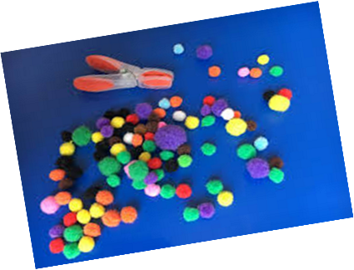
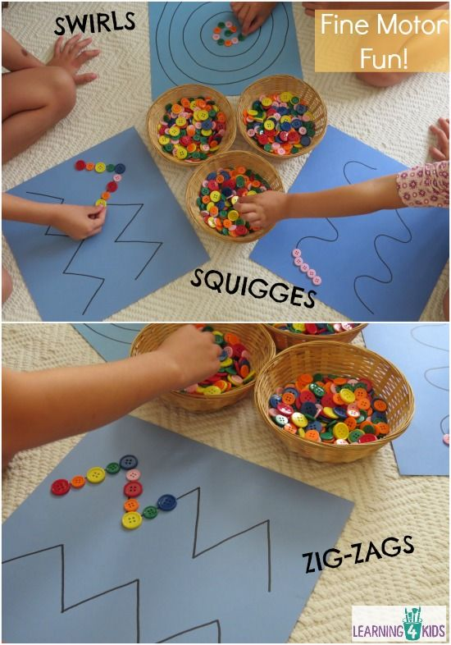
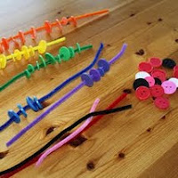
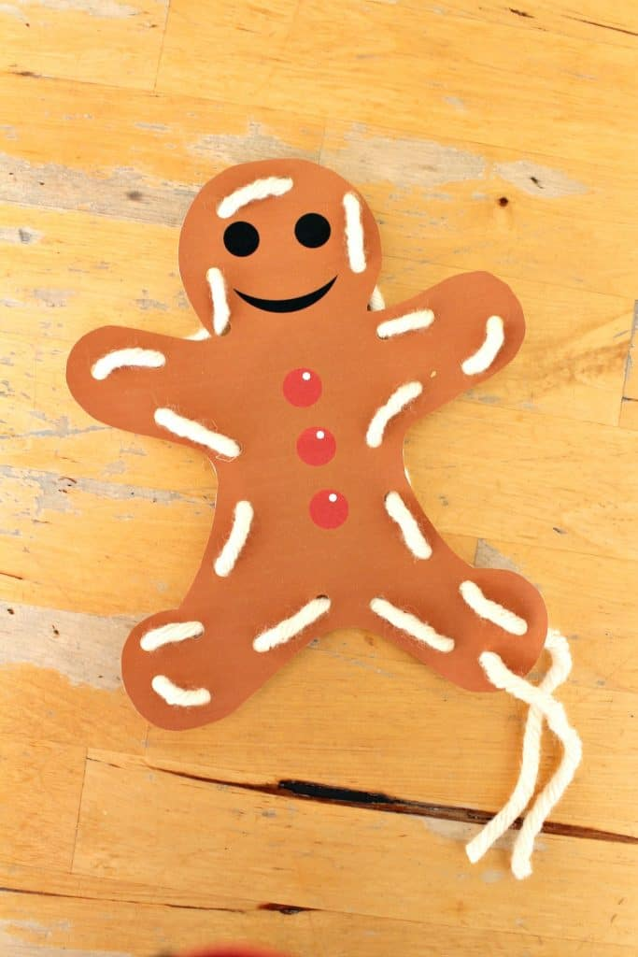
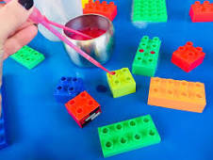
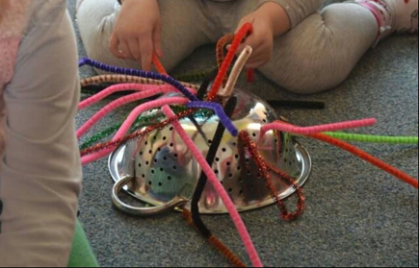
Fine motor activities

